Slide 1

Department of Computer Science & Engineering
(Artificial Intelligence and Machine Learning)
Internship Presentation(AM82231A)
on
Artificial Intelligence & Data Science
at
Kakunje Software Private Ltd
Under the Guidance of:
Ms. Shreekshitha
Asst. Professor
Dept. of CSE(AI&ML), SCEM
Mr. GK Bhat Kakunje
CEO&MD
Kakunje Software Pvt Ltd
Presented by:
Nehan Shaikh– 4SF22CI061

Slide 2
Contents
About the Company
Vision, Mission of the Company
Customer and Products
Internship Objectives
Internship Details (Week wise)
About Training
Technical Knowledge Gained
Internship Outcomes
References

Slide 3
About the Company
Kakunje Software Private Limited is a tech company based in Mangaluru that focuses on solving real-life problems using modern technology.
It helps businesses grow by providing digital services and guiding them through their digital transformation.
The company builds smart solutions like AI-based software, websites, mobile apps, and ERP systems .

Slide 4
About the Company (Cont’d..)
They also develop platforms like CRM, CMS, and e-commerce systems to meet different business needs.
Kakunje works in areas like healthcare, agriculture, automation, and electronics.
They create advanced technologies such as IoT devices, embedded systems, and AI-powered robotics.

Slide 5
About the Company (Cont’d..)
Along with development, they support students through internships, training, and project guidance.
Their goal is to give hands-on experience and help learners build practical skills through workshops and real-world projects.

Slide 6
Vision, Mission of the Company
Vision:
To lead the next generation of technological innovation by engineering innovative ideas into intelligent products and solutions that empower industries

Slide 7
Vision, Mission of the Company
Mission:
To apply innovative engineering principles,modern technologies, and advanced toolsthrough a unique project development cycle to create smart, reliable solutions that solve real-world challenges, empower industries.

Slide 8
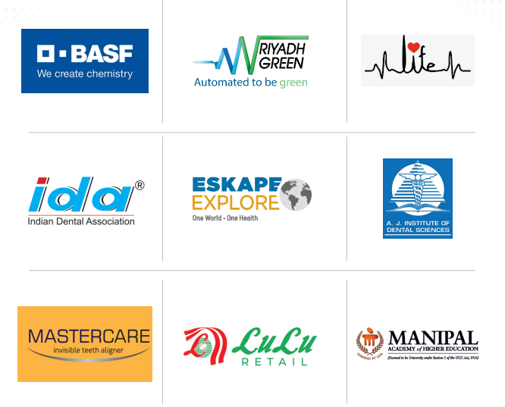
Customers

Slide 9

Customers (Cont’d)

Slide 10
Products
AI Enabled Soil Tester: This device checks soil quality by measuring important factors like pH, moisture, and nutrients. It helps farmers understand what the soil needs for better crop growth. It saves time and supports smarter farming decisions.
IoT Water Quality Monitor System: This system tests water quality by checking parameters like pH, turbidity, and dissolved solids. It can be monitored remotely in real time from anywhere. It is useful for homes, industries, and water treatment plants.

Slide 11
Products
Reverse Vending Machine (RVM) This smart machine collects recyclable items like plastic bottles, cans, and glass. In return, users can receive rewards or incentives. It promotes recycling and helps keep the environment clean.
GPS GSM Based Truck Tracking System This system tracks the live location of trucks using GPS technology. Owners can also monitor speed, route history, and movement updates. It improves safety, delivery management, and transport efficiency.

Slide 12
Products
AI Enabled Spirometer This device helps measure lung health and breathing performance using a smartphone. It can detect problems like asthma or COPD at an early stage. It makes health monitoring easier and more accessible.
AI Enabled Water Meter & Billing System This smart solution measures water usage accurately and automates billing. It can also control water supply valves when needed. It is ideal for apartments, malls, and shared buildings.

Slide 13
Internship Objectives
To gain practical knowledge of Python, Machine Learning, Deep Learning, OCR, NLP, and GUI development.
To improve coding, analytical thinking, and problem-solving skills through hands on tasks.
To understand how real time software applications are designed and implemented.
To apply learned concepts in given project.

Slide 14
Week-1
Got introduced to the company, internship objectives, and training schedule.
Installed Python, VS Code, and required software tools.
Learned basic Python concepts like variables, loops, and functions.
Practiced simple programs for better understanding.
Understood how the internship would progress week by week.

Slide 15
Week-2
Learned advanced Python concepts like lists, dictionaries, and file handling.
Practiced problem solving programs using Python.
Improved coding logic through hands on exercises.
Understood error handling and debugging basics.
Worked on small tasks to strengthen fundamentals.

Slide 16
Week-3
Learned NumPy for numerical operations and arrays.
Studied Pandas for data handling and analysis.
Practiced cleaning datasets and handling missing values.
Worked on sorting, filtering, and transforming data.
Learnt about advanced matplotlib operations
Learned the importance of preprocessing data.

Slide 17
Week-4
Introduction to Machine Learning concepts and workflow.
Learned supervised and unsupervised learning basics.
Studied algorithms like KNN, Decision Tree, and Random Forest.
Trained models using sample datasets.
Evaluated accuracy and compared model results.
Understood how machines learn from data.

Slide 18
Week-5
Learned more ML algorithms like SVM and Naive Bayes.
Practiced classification and prediction tasks.
Understood training and testing data split.
Learned model evaluation methods.
Improved problem-solving using ML techniques.
Gained practical experience in implementing models.

Slide 19
Week-6
Introduction to Deep Learning and neural networks.
Worked with TensorFlow and Keras libraries.
Built neural network models.
Learned about layers, epochs and activation functions.
Practiced prediction using trained models.

Slide 20
Week-7
Learned image processing basics using Python libraries.
Worked on reading, resizing, and enhancing images.
Understood feature extraction techniques.
Practiced handling image datasets.
Specially applied CNN for many datasets and understood it clearly.
Gained practical exposure to computer vision basics.

Slide 21
Week-8
Learned OCR for extracting text from images and scanned documents.
Practiced converting image text into editable digital data.
Studied NLP for text cleaning and processing.
Learned keyword extraction and data structuring.
Assigned with project, team formation and divided the modules.

Slide 22
Week-9
Learned PyQt for creating desktop applications.
Designed simple user interfaces for project modules.
Understood integration of frontend and backend logic.
Started working on AI-Based Intelligent ERP System project.
Started with requirement analysis for the project
Prepared the structure for final project development.

Slide 23
Week-10
Implemented alert logic for:
Low Stock Alerts
Expiry Alerts
Demand Surge & Sales Drop Alerts
Integrated Python system with MySQL database
Fetched real-time data (inventory, sales, expiry)
Generated alerts based on business rules
Stored alerts in database for further processing

Slide 24
Week-11
Developed backend APIs for alert retrieval
Integrated alerts with frontend dashboard
Implemented filtering & sorting features
Performed end-to-end testing (DB → Backend → UI)
Fixed bugs and optimized system performance.

Slide 25
About Training
The training was practical, interactive and well structured.
Each topic was explained with examples and coding practice.
Trainers were very helping and was reachable at any time.
Training covered both fundamentals and advanced concepts.
Tasks were given each day related to the topics covered on that day.

Slide 26
Technical Knowledge Gained
Python Programming
NumPy and Pandas
Data Visualization
Machine Learning Algorithms
Deep Learning Basics
TensorFlow and Keras

Slide 27
Technical Knowledge Gained (Cont’d)
OCR
NLP
PyQt GUI Development
Model Evaluation and Testing
Project Development Workflow
Github collaboration

Slide 28
Internship Outcomes
Improved coding and technical knowledge in multiple domains.
Gained more practical experience in AI and ML concepts.
Learned how to build intelligent real time applications.
Working on AI-Based Intelligent ERP System project.
Improved communication skill and leadership skills.
Got to learn new libraries and modules in python.

Slide 29
References
[1] https://kakunjesoftware.com/#about
[2] https://github.com/NehanShaikh/Kakunje_Internship
[3] https://github.com/Nithin3302/AI-ERP-PROJECT.git

Slide 30
Thank You

